Slide 1
SCANNER 3D
Mentor: Akshay Chipkar
Project Manager: Rajesh Kushalkar
Program Director: Avinash Awate
Under the guidance of
Prof. D. B. Phatak

Slide 2
TEAM MEMBERS
1. Anchal Singh Panwar, NIT Uttarakhand
2. Animesh Srivastava, NIT Hamirpur
3. Sagar Satapathy, NIT Rourkela
4. Soumya Sambit Rath, NIT Rourkela

Slide 3
Contents
Overview
Software Specifications
Hardware Specifications
Fault analysis and Documentation

Slide 4
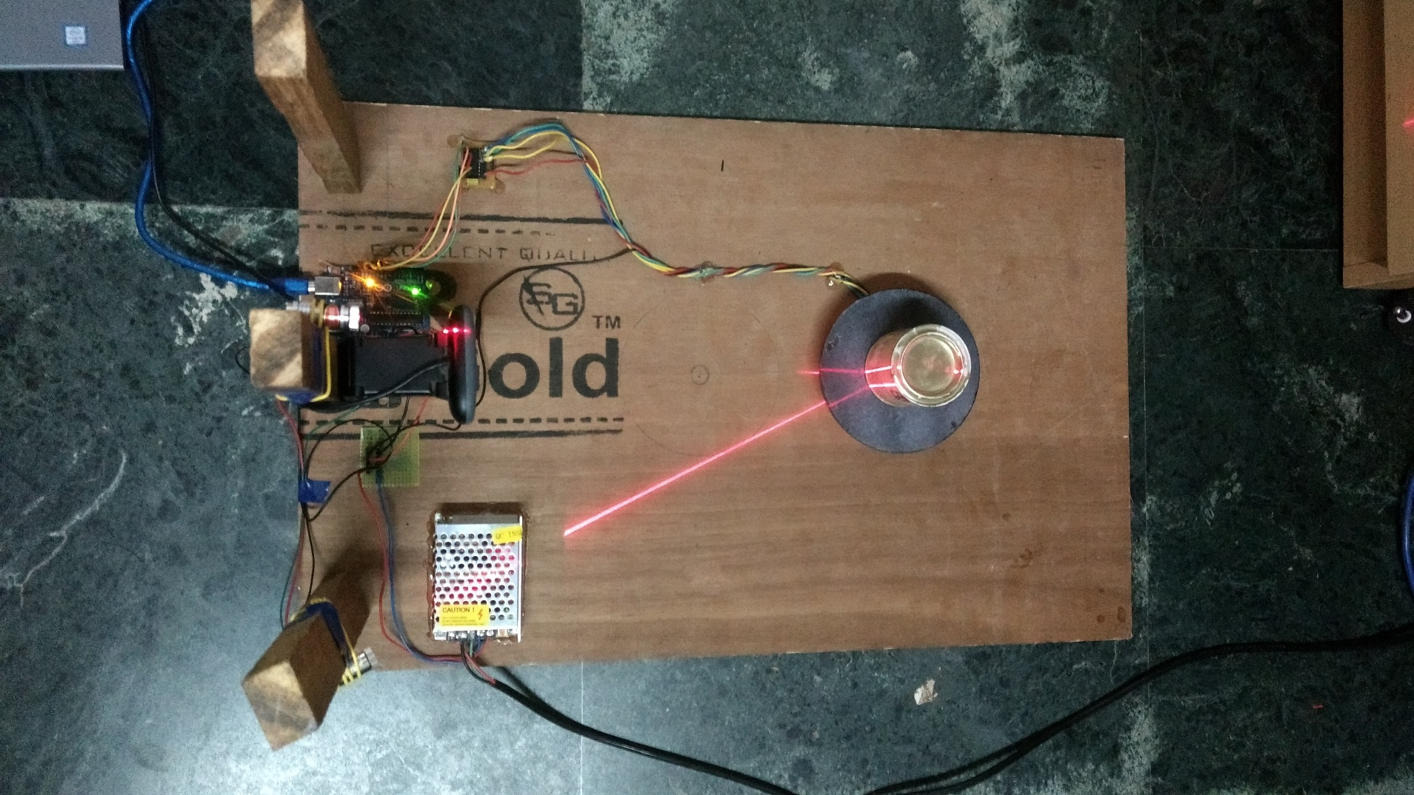
3D Scanner

Slide 5
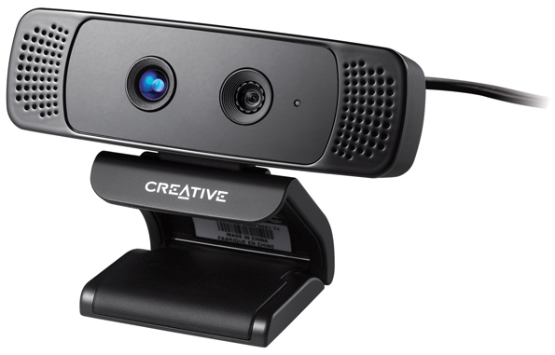
Present technologies used for 3D Scanning:
3D Shape Scanning using time-of-flight camera :
Range Imaging
Based on speed of light
Uses Infrared light signal

Slide 6
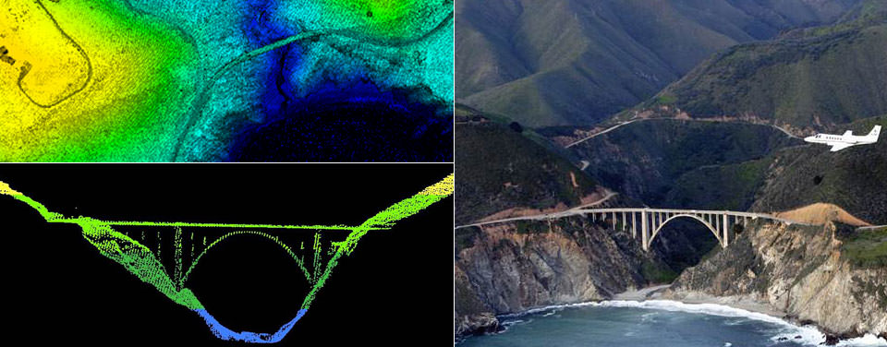
2. LIDAR based 3D Scanner:
Light Detection and Ranging
Based on difference of wavelength and time of flight.
Uses Pulsed Laser technology

Slide 7
Objectives
Easily available hardware
Construction of depth from 2D images
Extraction of the useful data from the camera captured images by using Image Processing.
Code for all the algorithms designed and decided to be used
User-friendly software interface
Generation of 3D file
Plotting the output

Slide 8






Open source technologies used:
Python 2.7
OpenCV 3.2.0
Numpy 1.13.0
Matplotlib 2.0.2
Tkinter
Pygame 1.9.1
PyOpenGL 3.1.0
Pyserial 2.6
Arduino UNO

Slide 9
Software Development Process
Capturing a 360⁰ view of the image
Creation of a 3D object file
Extraction of useful contours from the image
Conversion of 2D coordinates to 3D coordinates
Plotting the 3D image
Filtering the 3D image

Slide 10
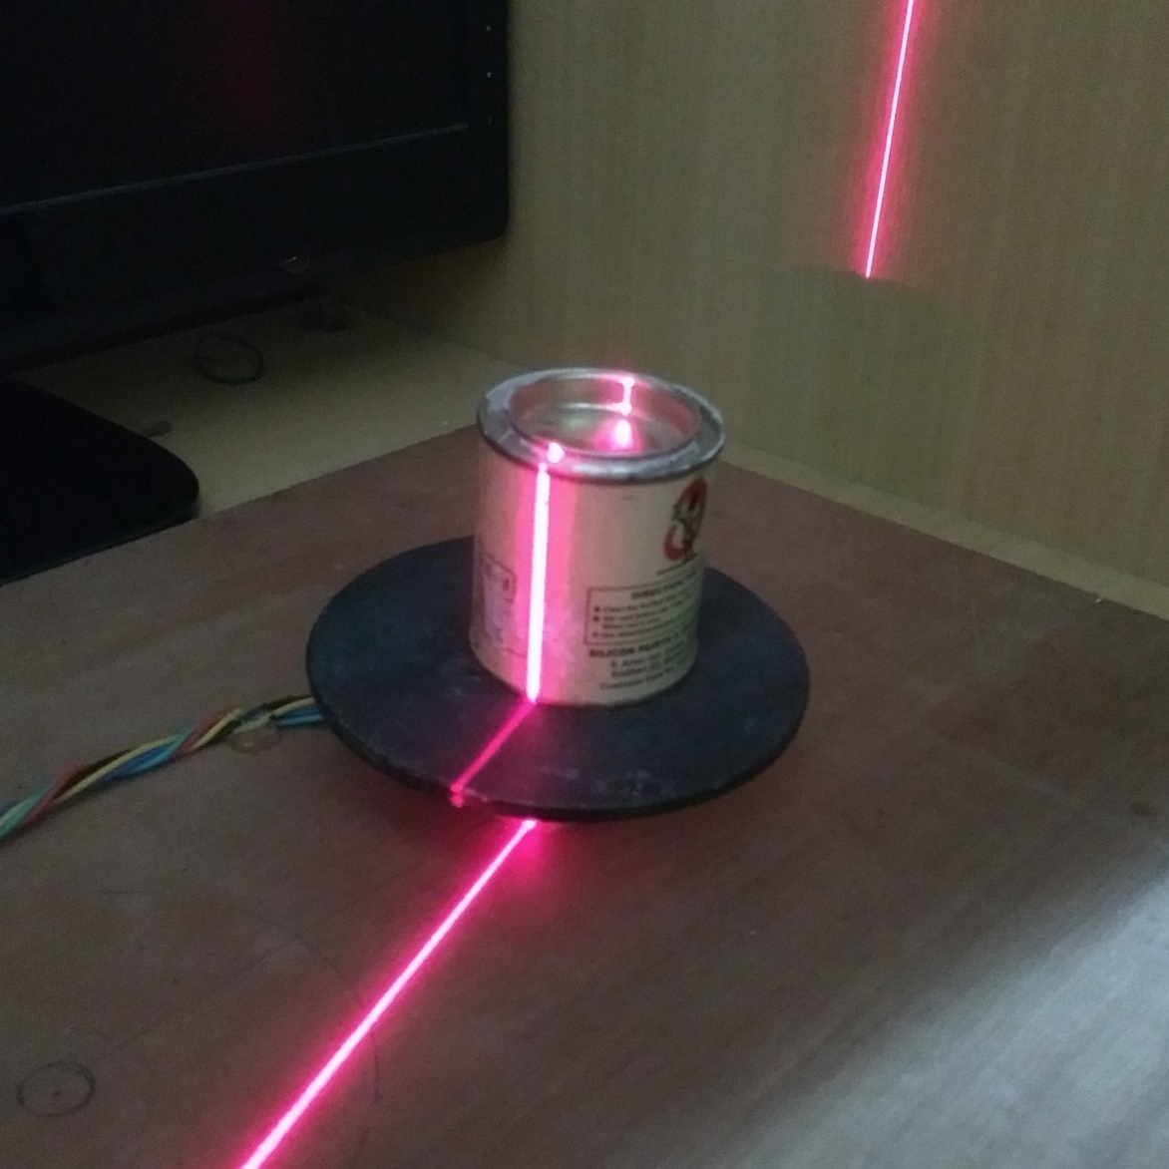
Capturing a 360⁰ view with the camera

Slide 11
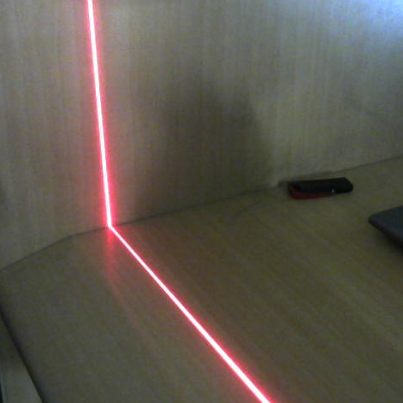
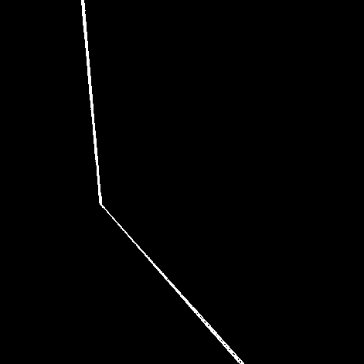
Extraction of useful contours from the image

Slide 12
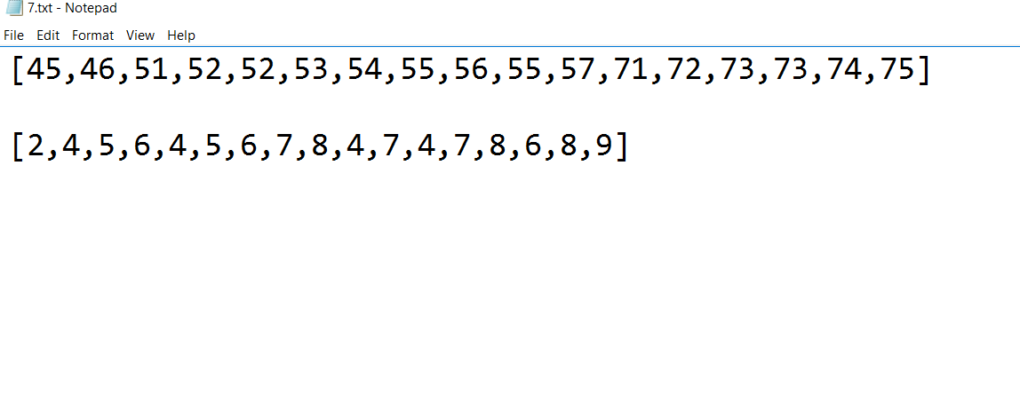
Sample .txt file

Slide 13
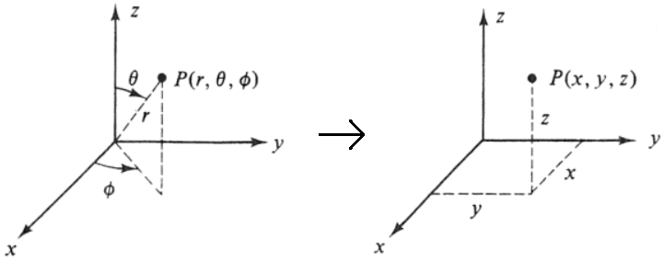
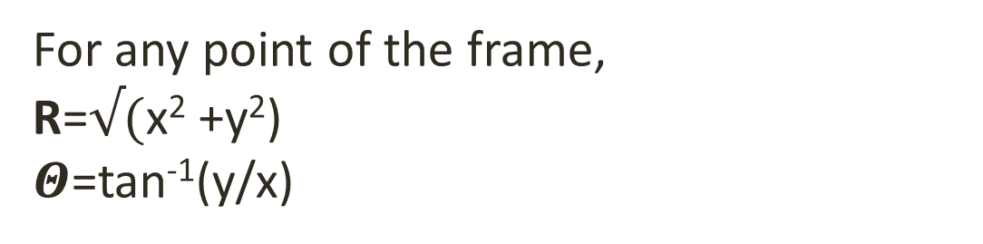
Conversion of 2D coordinates to 3D coordinates
For any point of the frame,
R=$√($x² +y²)
$Θ$=tan⁻¹(y/x)
48 steps =360⁰
1 step = 7.5⁰
For n^{th} step, ɸ= n*7.5⁰

Slide 14
Creation of a 3D object file
.ply (Polygon Format File) file
Defining the headers
Adding the vertices
Adding the faces

Slide 15
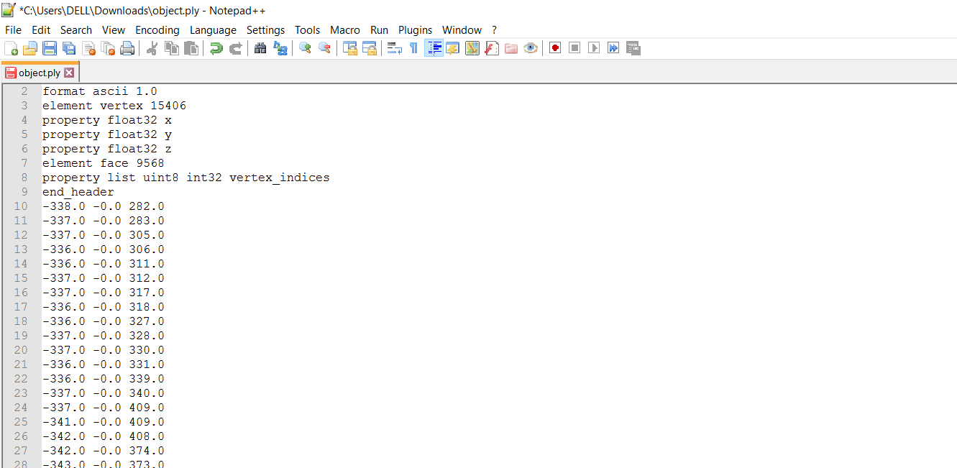
Sample .ply file

Slide 16
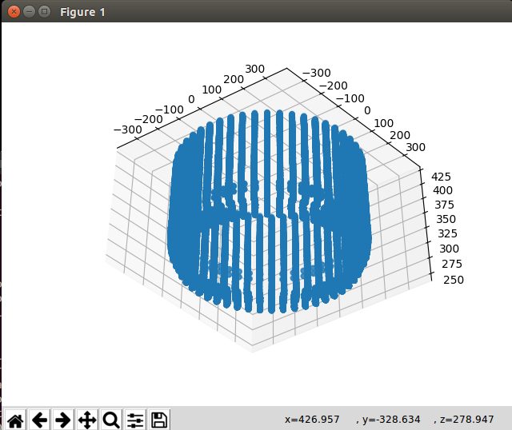
Plotting the point cloud (Scatter Plot)

Slide 17
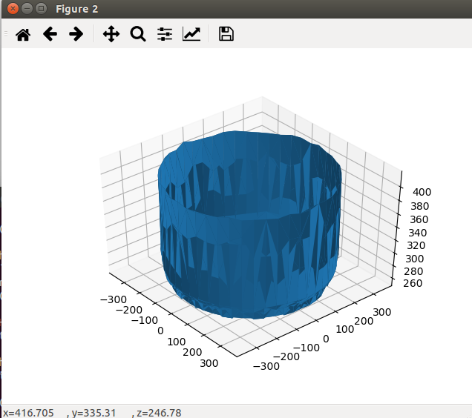
Plotting the Surface Plot

Slide 18
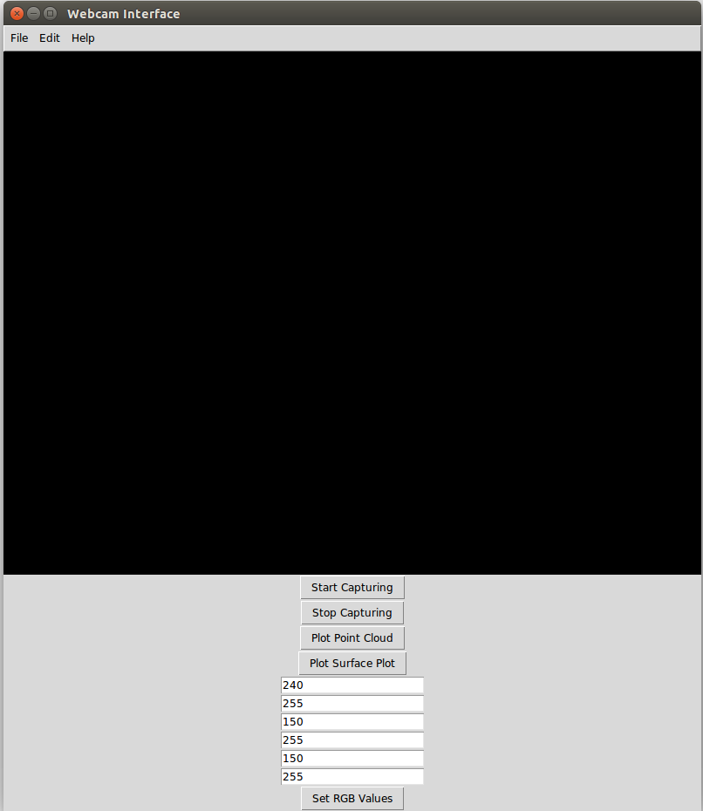
Main Window of the software

Slide 19
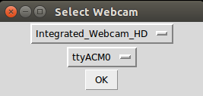
Option for choosing the camera and the arduino

Slide 20
Hardware
Stepper Motor to rotate the platform
Arduino MCU for controlling the stepper from the code
Motor Driver for running the stepper motor
Power Supply Module

Slide 21
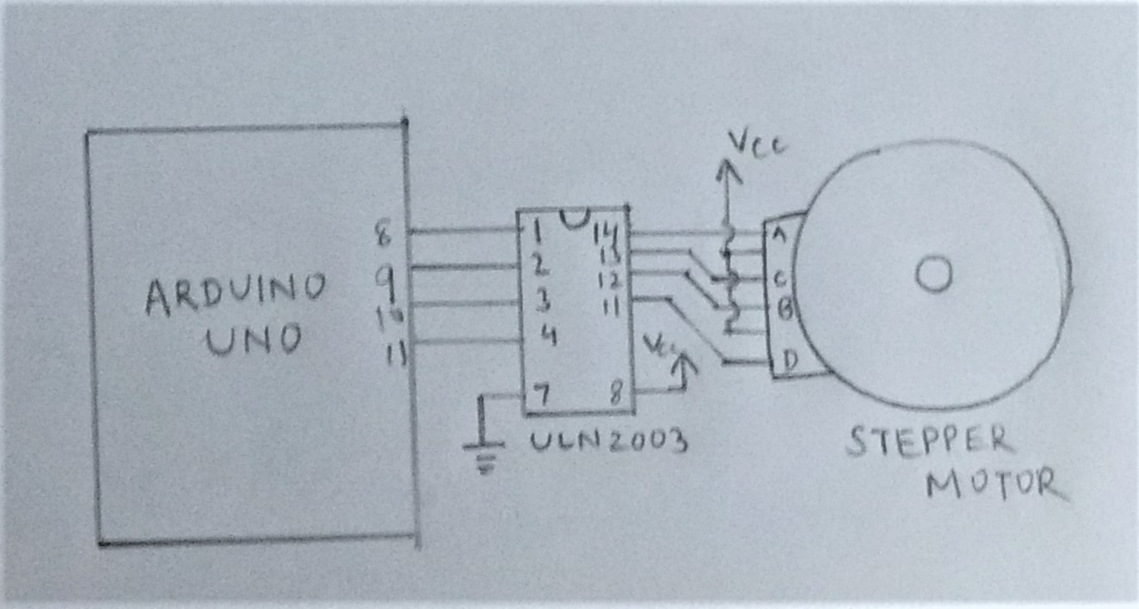
Circuit connections

Slide 22
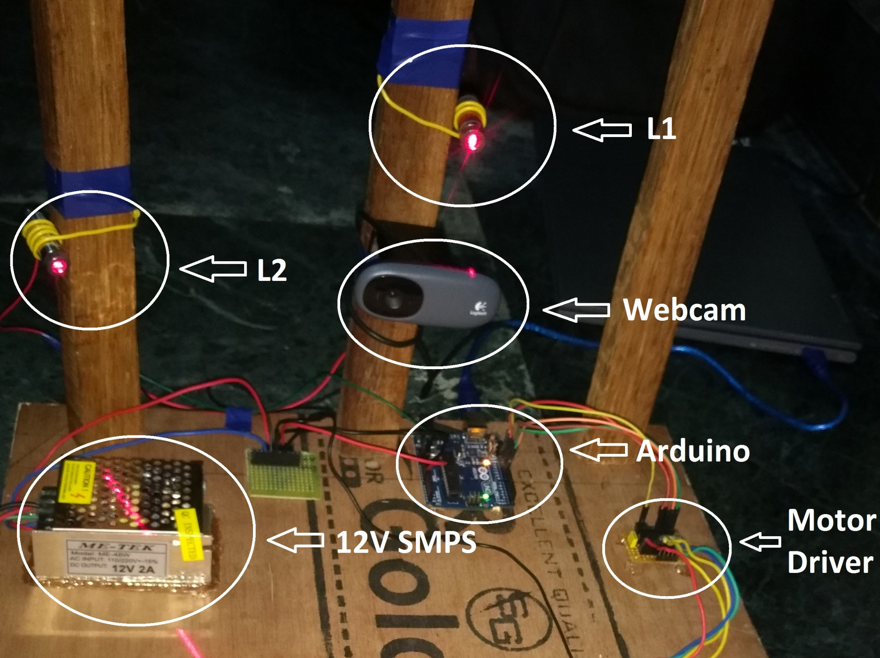

Slide 23
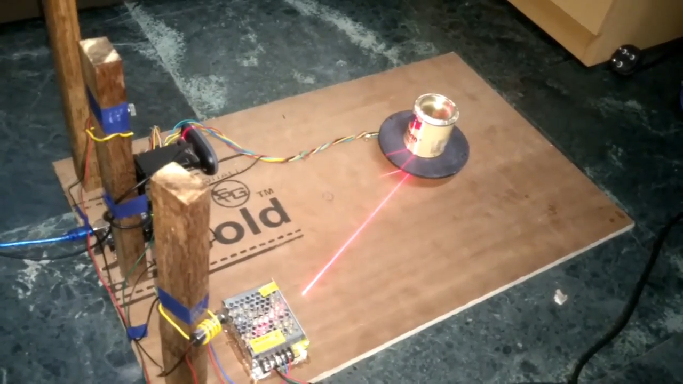

Slide 24
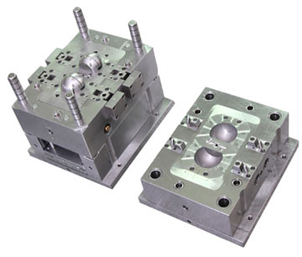

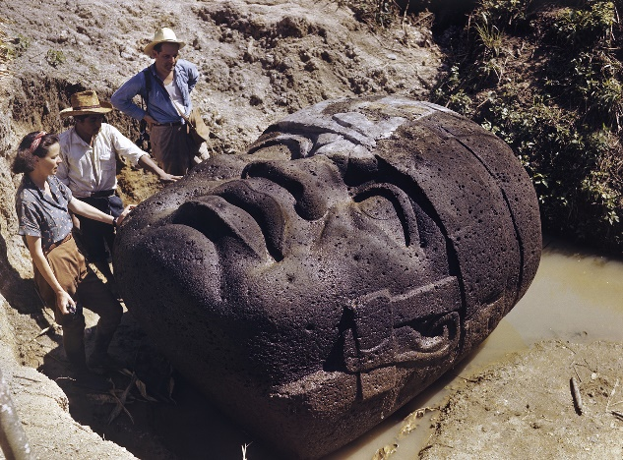
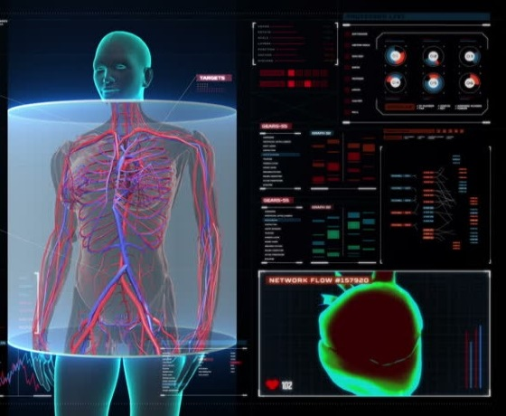
Applications
Industrial design
Healthcare and medicine
Archaeology
Education

Slide 25

Issues with the present design
Inefficient conversion algorithm
Unable to scan 90⁰ edges and pointed corners
Poor 3D resolution
Slow image processing and plotting

Slide 26
What more to be done in the project
Better algorithm for capturing 90⁰ corners
Reduction in the no. of points captured inside the contour
Construction of faces
Improvement of the GUI platform
Platform Independence

Slide 27
Documentation
Github Repository
Proper comments in code
Wiki
Project Report
Practical Product Analysis
Comparison

Slide 28
Skills learnt during the project:
Analytic Thinking
Python programming
Mathematical modelling with Numpy
GUI development with Tkinter
Image processing with OpenCV
Art of Documentation
Github
Collaborative development

